Slide 1
Phase I Clinical Trials

Slide 2
Introduction
Phase I Trial: First study in which a new drug is administered to human subjects (“First in Human”)
Follows previous studies in animals and/or lab experiments
Objectives:
Determine a safe, tolerable dose
Develop an appropriate schedule of administration
Intended to be efficient and quick, with few subjects exposed to new drug

Slide 3
Types of Studies
Dose-finding studies (Phase I)
Determine the maximum dose that can be given without serious problems or adverse events
Often preceded by pre-clinical studies (“Phase 0”)
In-vitro studies: lab experiments using biological tissue, but not actual organisms
Dose-finding / pharmacology studies in animals
Scale up animal findings to predict action in humans
Circumvent ethical issues involved in human subjects research

Slide 4
Dose-finding Studies
Establish a therapeutic dose to be evaluated in follow-up (Phase II) trial
Higher doses tend to increase both toxicity and efficacy for most therapies
Measuring toxicity:
Problems or side effects arising as a direct response to the administration of the drug
Nature of toxicity depends on drug
May be life-threatening
May be reversible

Slide 5
Toxicity Measurement
Toxicity Grade: Ordinal score of toxicity severity
NIH Common Terminology Criteria for Adverse Events (CTCAE) grading criteria are typically used
Cancer therapy example:
Grade V=Death
Toxicity | I | II | III | IV
Abdominal pain | Mild | Moderate (requiring no treatment) | Moderate (requiring treatment) | Severe (Hospitalization)
Creatinine clearance (mL/min) | 60-75 | 50-59 | 35-49 | <35

Slide 6
Toxicity Measurement
What level of toxicity is “acceptable”?
Defined by investigators
Dose-limiting toxicity (DLT):
Serious, but possibly reversible, toxicity attributed to therapy
Often used for dose-finding in cancer research
Maximum Tolerated Dose (MTD):
Highest possible dose with an “acceptable” rate of DLTs
“Acceptable” toxicity rate set by investigators in consideration of potential benefit to patients (usually in 20-35% range)

Slide 7

Notation for Dose Finding
Patients treated in sequence such that:
$d_{i}=$ Dose for $i^{th}$ patient
$Y_{i}=$ Toxicity status for $i^{th}$ patient, where
$Y_{i}=$1 if DLT occurred, 0 if no DLT occurred
MTD is the dose such that $P\left(Y=1 | Dose=MTD\right)=θ$, where $θ$ is the maximum acceptable proportion of DLTs
$θ=1/3$is often chosen for cancer studies

Slide 8


Dose Response
Dose Levels
1
2
3
4
5
6
1.0
0.8
$$MTD:$$
$$\frac{6.1 mg}{m^{2}}$$
0.6
Probability of DLT
0.4
$$P(DLT)=1/3$$
0.2
0.0
0
2
4
6
8
10
Dose (mg/m²)

Slide 9

Dose-Response Models
Logistic Model: $P\left(Y=1 | d\right)=\frac{e^{β_{0}+β_{1}d}}{1+e^{β_{0}+β_{1}d}}$
Probit Model: $P\left(Y=1 | d\right)=Φ(μ+σd)$,
where $Φ$ is the standard normal CDF
Hyperbolic Tangent Model:
$P\left(Y=1 | d\right)={\left\{0.5\left[\tanh\left(a_{0}+a_{1}d\right)+1\right]\right\}}^{−a_{2}}$

Slide 10

Dose-Response Functions
Logistic Model with $β_{0}=−10,β_{1}=0.4$:

Slide 11

Ideal Design: Randomized Dose Design
Select doses $d_{1}, …, d_{k}$ such that some dose will be close to the MTD
Randomize subjects to each dose, $n_{i}$ subjects at dose $d_{i}$
Observe $r_{i}$ patients exhibiting DLT at dose $d_{i}$
$P\left(Y=1 | Dose=d_{i}\right)$ can be estimated by $r_{i}/n_{i}$ for each $d_{i}$
Modeling dose-response relationship can share information across doses:
$Ψ(d|η)=P(Y=1|dose=d)$for parameter $η$, where $Ψ$ is a non-decreasing, continuous function in $d$
Then $MTD=Ψ^{−1}(θ|η)$
In practice, we estimate $η$ using the data, then plug in the estimated value to find the $MTD$

Slide 12
Randomized Dose Design: Issues
Ethical issues:
First time drug is tested in humans; better to start with low doses first
Don’t want to treat too many patients at too low (ineffective) or too high (unsafe) a dose
Unethical to randomize patients to different doses given dose-toxicity relationship – patients randomized to higher doses expected to have higher (possibly excessive) risk

Slide 13

Adaptive / Dose-escalation Designs
Start with a low dose in a few subjects
If no toxicities, try a higher dose in a few more subjects
Continue until dose with excessive toxicity is found
Possible dose de-escalation
Many variations on this principle
Small sample size ($≤30$) is common, may not be fixed in advance
Often these are ad-hoc, non-statistically motivated designs that are intuitive to clinicians

Slide 14
3+3 Designs
Widely used dose-finding design for oncology
3+3 Designs:
Patients treated in cohorts of size 3
Start at lowest dose level
For the current cohort:
If 0/3 toxicities, escalate to next dose and treat next cohort
If >=2/3 toxicities, STOP
If 1/3 toxicity, treat additional 3 subjects at same dose
If 1/6, then escalate to next dose and treat next cohort
If >=2/6, STOP
Notes:
Most commonly used. Many different patients in cohorts. Each cohort gets a dosage, and then if that cohort passes then the next cohort tests a higher dosage.

Slide 15
3+3 Designs
3+3 Designs:
Definition of MTD usually is either
Dose at which trial stops
Next lowest dose in sequence
Some fraction of last dose
Often, additional patients are added at the MTD up to a fixed number to get a more precise toxicity estimate (“dose-expansion”)
Notes:
MTD = Maximum tolerated dosage

Slide 16
3+3 Design Example
Dose 5 is MTD

Slide 17

Determining Initial Doses
From rodent studies, estimate of $LD10$ may be available
$LD10=$ Dose that is fatal for 10% of rodents
Start with 1/10 of the rodent $LD10$ on a mg/kg basis (e.g. scaled from rodent to human size)
From larger animal (e.g. dog, monkey)
Determine Toxic Dose Level (TDL), the lowest dose at which any toxicity is seen
Start with 1/3 of the TDL
Notes:
TDL = Toxic Dose Level

Slide 18

Determining the Dose Sequence
Modified Fibonacci Sequence:
Ordinary Fibonacci sequence: $1, 1, 2, 3, 5, 8, 13, 21,…$
Ratios of successive terms:
$\frac{1}{1},\frac{1}{2},\frac{2}{3},\frac{3}{5},\frac{5}{8},\frac{8}{13},\frac{13}{21},…→0.61803=61.8\%$
Ratios used to determine increases in doses between levels
Sequence of ratios modified to produce smaller dose increases
Notes:
Very cool. Golden ratio used.

Slide 19
Modified Fibonacci Sequence: Example
Piantadosi, Table 10.2:
Dose Level | Dose (Fibonacci) | Dose (Modified) | % Increment (Modified)
1 | D | D | -
2 | 2 X D | 2 X D | 100
3 | 3 X D | 3.3 X D | 67
4 | 5 X D | 5 X D | 50
5 | 8 X D | 7 X D | 40
6 | 13 X D | 9 X D | 29
7 | 21 X D | 12 X D | 33
8 | 34 X D | 16 X D | 33
Notes:
This table outlines dose levels.
Dose 1 = Dose
Dose 2 = 2*Dose
Dose 3 = 3*Dose
Dose 4 = 5*Dose
etc.

Slide 20

Operating Characteristics: 3+3 Design
Want high probability of terminating at or near the optimal dose (true MTD), regardless of the design points
Probability of stopping before MTD should be low
Probability of escalating past MTD should be low
Binomial outcome: # of events in n patients
Event = DLT
Independent patients
Binomial probability of $r$ events out of $n$ patients with event probability $p$:
$$b\left(r | n,p\right)= \frac{n!}{r!\left(n−r\right)!}p^{r}{(1−p)}^{n−r}, r=0, 1, 2,…,n$$

Slide 21
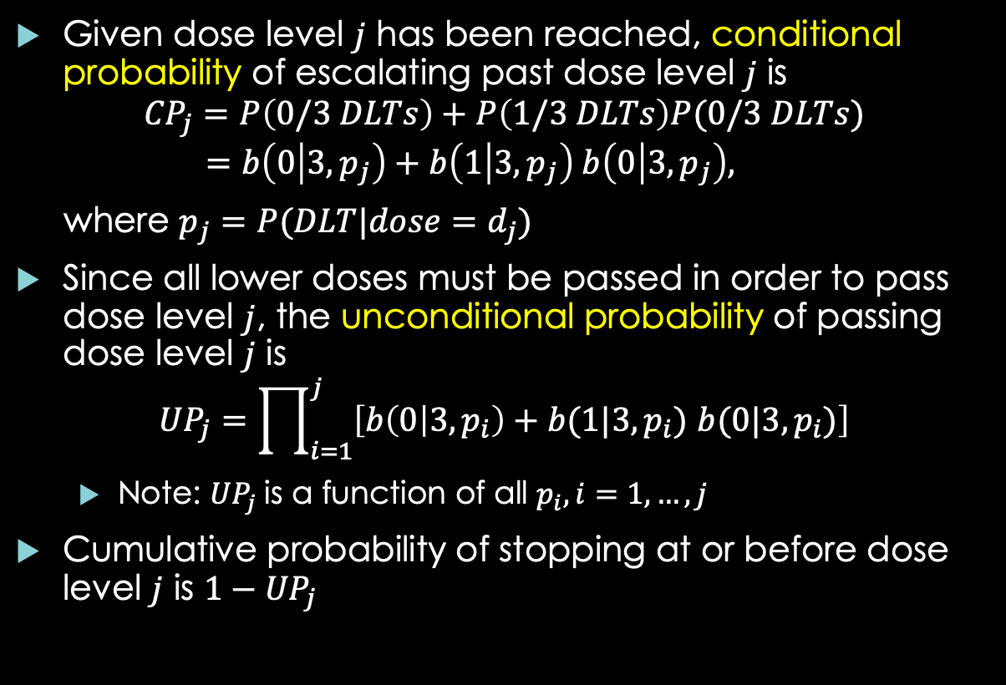
Operating Characteristics: 3+3 Design
Given dose level $j$ has been reached, conditional probability of escalating past dose level $j$ is
$${CP}_{j}=P\left(0/3 DLTs\right)+P\left(1/3 DLTs\right)P(0/3 DLTs)$$
$$=b\left(0 | 3,p_{j}\right)+b\left(1 | 3,p_{j}\right) b\left(0 | 3,p_{j}\right),$$
where $p_{j}=P(DLT|dose=d_{j})$
Since all lower doses must be passed in order to pass dose level $j$, the unconditional probability of passing dose level $j$ is
$${UP}_{j}=\prod_{i=1}^{j}{\left[b\left(0 | 3,p_{i}\right)+b(1|3,p_{i}) b(0|3,p_{i})\right]}$$
Note: ${UP}_{j}$is a function of all $p_{i}, i=1,…,j$
Cumulative probability of stopping at or before dose level $j$ is $1−{UP}_{j}$

Slide 22
Operating Characteristics: 3+3 Design Example
Piantadosi, Figure 10.2:
MTD B
MTD A

Slide 23
Operating Characteristics: 3+3 Design Example
Piantadosi, Figure 10.3 (A and B mislabeled in book)
MTD B
MTD A

Slide 24
Operating Characteristics: 3+3 Design Example
Scenario A: True MTD = 7.4
40% chance of stopping at dose 6 or earlier
E(estimated MTD) between 6 and 7
Scenario B: True MTD = 5.3
70% chance of stopping before dose 4
E(estimated MTD)=3

Slide 25
3+3 Design Properties
Benefits:
Easy for investigators to understand
Dose escalation / de-escalation rules can be written explicitly before study
No statistical modeling required
Drawbacks:
MTD estimate tends to be biased (dose too low)
Tends to treat most subjects at too low of a dose
No statistical guidance for dose changes or precision of MTD estimate
“Memoryless”, in that only last 3-6 patients can inform dose modifications
Notes:
Not statistically rigorous, but easy to understand for investigators.
!NO STATISTICAL GUIDANCE FOR DOSE CHANGES

Slide 26
Algorithmic Designs
3+3 design is an example of an algorithm-based design:
Dose escalation / de-escalation rules are prespecified, based on intuition rather than statistical reasoning
Variations on 3+3 have been proposed:
2+4, 3+1+1(“best of five”), 3+3+3, “rolling six design”, etc.
Same benefits and drawbacks apply as for 3+3

Slide 27

Continual Reassessment Method (CRM)
O’Quigley, Pepe, Fisher (Biometrics, 1990)
Patients treated sequentially (one at a time):
Dose-toxicity curve is refit after each patient
New curve is used to estimate the MTD
Treat the next patient at the dose closest to the MTD
Continue until fixed number of patients have been treated or a stopping rule is triggered
Likelihood-based or Bayesian procedure used to estimate $MTD$
Notes:
CRM METHOD!
Fitting a Dose-Toxicity curve to estimate & adjust per each patient treated.

Slide 28

CRM: Likelihood Estimation
Suppose we have a candidate set of doses $\{d_{1},…,d_{k}\}$
After the $m^{th}$ patient’s response is observed, parameter $η$ estimated by maximizing the likelihood function using the first $m$ patients’ data
Probability of a toxic response at dose $d_{j}$ is estimated by $\hat{P}\left(Y=1 | d_{j}\right)=Ψ(d_{j}|\hat{η})$
Next patient assigned dose with $\hat{P}\left(Y=1 | d_{j}\right)$ closest to $θ$
Notes:
Google the Likelihood function. The toxic response is a simple Y/N, so it follows a Bernoulli mass function.

Slide 29

CRM: Considerations
Choice of Model:
1-parameter model is needed to get stable estimates for small $m$
May not fit dose-response curve well, but is sufficient for estimating $P\left(Y=1 | d\right)$
1-parameter logistic model is a common choice:
$Ψ\left(d | η\right)=\frac{e^{η+ad}}{1+e^{η+ad}}$ for constant $a$ works poorly
$Ψ\left(d | η\right)=\frac{e^{a+ηd}}{1+e^{a+ηd}}$ for constant $a$ works OK; can specify $a$ based on data from preclinical studies, similar therapies (e.g. $a=−3$)
Notes:
Typically a = -3. WE use the bottom most model.
The model is reupdated after each cohort.

Slide 30

Likelihood-based CRM
Maximizing likelihood / estimating $η$:
Need heterogeneity of response data in order to fit model
At least one toxicity and one nontoxicity needed
May not be able to fit model for early patients
Two-stage strategy to compensate:
Stage 1: Treat individual pts at escalating doses until first toxicity observed
Stage 2: After first toxicity, apply CRM and use likelihood based inference to estimate $η$ and $MTD$

Slide 31
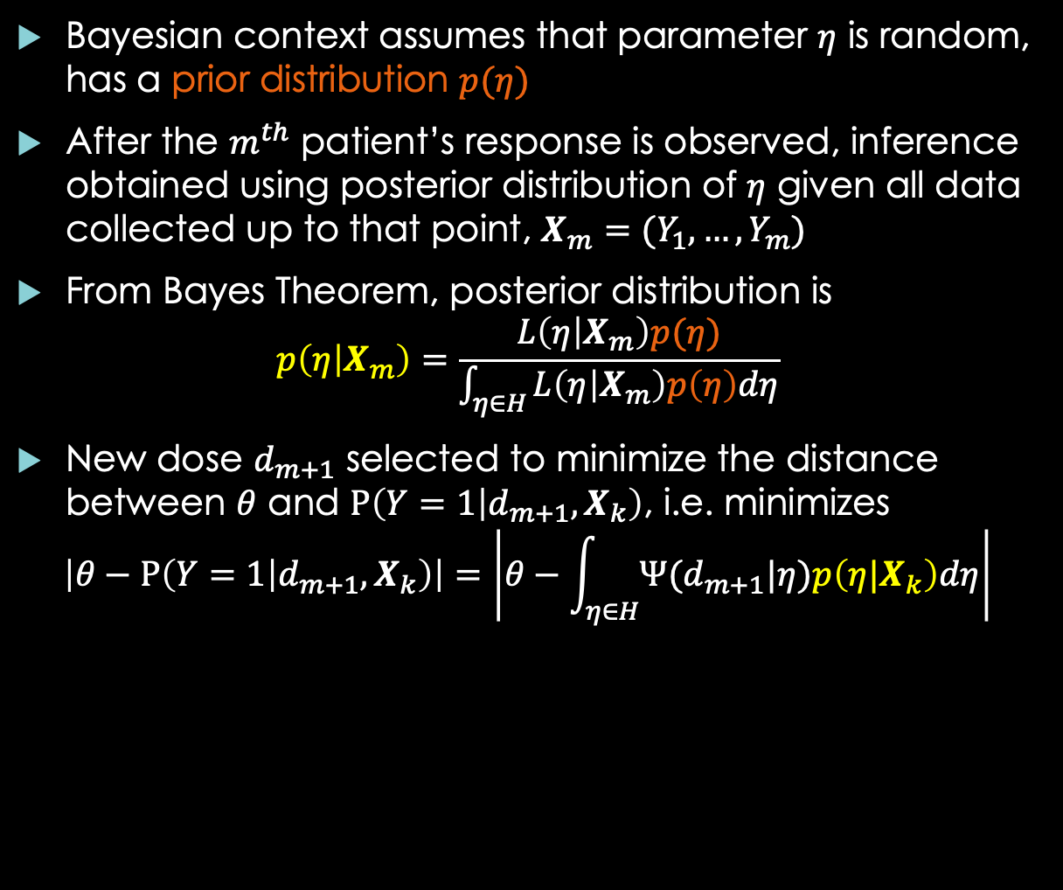
Bayesian CRM
Bayesian context assumes that parameter $η$ is random, has a prior distribution $p(η)$
After the $m^{th}$ patient’s response is observed, inference obtained using posterior distribution of $η$ given all data collected up to that point, $X_{m}=(Y_{1},…,Y_{m})$
From Bayes Theorem, posterior distribution is
$$p\left(η | X_{m}\right)=\frac{L\left(η | X_{m}\right)p(η)}{\int_{η∈H}^{ }{L\left(η | X_{m}\right)p\left(η\right)dη}}$$
New dose $d_{m+1}$ selected to minimize the distance between $θ$ and $P\left(Y=1 | d_{m+1},X_{k}\right)$, i.e. minimizes
$$\left|θ−P\left(Y=1 | d_{m+1},X_{k}\right)\right|=\left|θ−\int_{η∈H}^{ }{Ψ(d_{m+1}|η)p\left(η|X_{k}\right)dη}\right|$$
Notes:
Most commonly used. Google Bayes Theorem for a basic interpretation.
The prior distribution comes from the data.

Slide 32

Bayesian CRM
If there are many dose levels, a more computationally efficient method chooses $d_{m+1}$ to minimize
$\left|θ−Ψ(d_{m+1}|μ)\right|$,
where $μ=\int_{η∈H}^{ }{η∙p\left(η|X_{m}\right)dη}$ is the posterior mean of $η$
Choosing starting dose: Can use prior value of $MTD$, i.e. $d_{1}$minimizing
$$\left|θ−\int_{η∈H}^{ }{Ψ(d_{1}|η)p\left(η\right)dη}\right|$$

Slide 33
Properties of CRM
Benefits:
Fewer patients treated at too low or too high a dose
Dose level to which CRM converges is closest to true MTD
Drawbacks:
Jumping from low dose to much higher doses may be possible early in study
Sensitive to prior
Simulations should evaluate beforehand if this is an issue
Only 1 patient treated at a time; may produce longer study duration
Could avoid this by treating cohorts of > 1 at each dose
Dose escalation / de-escalation rule cannot be written down explicitly (“black box” nature of the model)
Analyst needs to rerun model after each cohort to determine next dose
Notes:
Does converge to the dose level closes to the MTD, which is what we want. It also treats more patients at or near the MTD.
It is much more complicated though, and might take more time to complete.

Slide 34
CRM Software
MD Anderson Cancer Center’s website:
Implementation of CRM found at
http://biostatistics.mdanderson.org/SoftwareDownload/
R package dfcrm
Notes:
WOOHOO

Slide 35
CRM Example Using R
R code (requires dfcrm package):
target = 0.33 # Target DLT rate for MTD
# Prior guesses of tox probs at doses
prior.prob = c(0.05,0.15,0.30,0.45,0.60,0.80)
tox.resp = c(0,0,1,0,0,0,1,0,0,0,1,0,0,0,0)
doselvl = c(1,2,3,2,3,3,4,3,3,4,4,3,4,4,4)
#doses = c("0.25mg","0.5mg","1mg","1.5mg","2mg","3mg")
# Fit CRM model
crmfit = crm(prior=prior.prob,target=target,tox=tox.resp, level=doselvl, model="logistic",method="bayes",patient.detail=FALSE)
# Summarize patient responses and fitted dose-response curve
crmfit
plot(crmfit)

Slide 36

Bayesian Optimal Interval (BOIN) Design
Liu and Yuan, JRSS Series C, 2014
At current dose $j$, use accumulated data to test:
$H_{0}:p_{j}= θ$ (null hypothesis), versus
$H_{1}:p_{j}= θ_{1}$ and $H_{2}:p_{j}= θ_{2}$ (alternative hypotheses), where $θ_{1}$, $θ_{2}$ are prespecified with $θ_{1}<θ<θ_{2}$
Decide dose level for next cohort as follows:
If ${\hat{p}}_{j}<λ_{1}$, escalate to dose $j+1$
If ${\hat{p}}_{j}>λ_{2}$, deescalate to dose $j+1$
If $λ_{1}<{\hat{p}}_{j}<λ_{2}$, remain at dose $j$
How to choose $θ_{1}$ and $θ_{2}$:
$(θ_{1}, θ_{2})$ can be viewed as an “indifference region”, where dose $j$ is acceptable as long as $p_{j} ε (θ_{1}, θ_{2})$
Notes:
Hypothesis testing at each dose.
Theta values are specified, but idk how.
Lambda is defined as “some threshold”.

Slide 37

BOIN Design
Under Bayesian hypothesis testing, prior probabilities of $H_{0},$ $H_{1},$ $H_{2}$need to be specified
Threshold values $λ_{1}$, $λ_{2}$ are chosen to minimize probability of making a wrong dosing decision
If ${P(H}_{0})={P(H}_{1})={P(H}_{2})=\frac{1}{3}$ is chosen, then:
$λ_{1}=\frac{log⁡\left(\frac{1−θ_{1}}{1−θ}\right)}{log⁡\left(\frac{θ(1−θ_{1})}{θ_{1}(1−θ)}\right)}$ and $λ_{2}=\frac{log⁡\left(\frac{1−θ}{1−θ_{2}}\right)}{log⁡\left(\frac{θ_{2}(1−θ)}{θ(1−θ_{2}}\right)}$
Testing using these thresholds is equivalent to performing likelihood ratio tests comparing $H_{1}$ to $H_{0}$ and $H_{2}$ to $H_{0}$
After target sample size $n$ is reached:
$p_{j}$’s are estimated using all data under monotonicity assumption $p_{j}≤ p_{j}$ for $i<j$ (e.g. isotonic regression)
MTD chosen to be dose $j$ with estimated $p_{j}$ closest to $θ$
Notes:
Lambda_n is based on theta_n.
Baysian means you have to set probabilities to each hypothesis. This ex has them all equal.

Slide 38

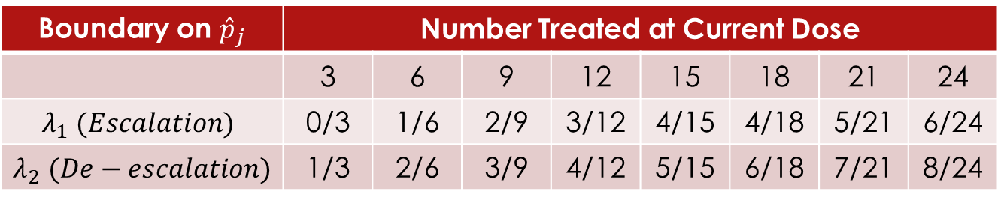
BOIN Design Example
Example: Dose finding study with targeted toxicity rate is $θ=0.30$ with 15 patients total,
Indifference region is $\left(θ_{1}, θ_{2}\right)=(0.25, 0.35)$
Patients treated in cohorts of size 3
At current dose, dose changing decisions are:
Boundary on ${\hat{p}}_{j}$ | Number Treated at Current Dose |  |  |  | Number Treated at Current Dose
 | 3 | 6 | 9 | 12 | 15 | 18 | 21 | 24
$$λ_{1} (Escalation)$$ | 0/3 | 1/6 | 2/9 | 3/12 | 4/15 | 4/18 | 5/21 | 6/24
$λ_{2}$ $(De−escalation)$ | 1/3 | 2/6 | 3/9 | 4/12 | 5/15 | 6/18 | 7/21 | 8/24
Notes:
Criteria for lambda is shown. We have cohorts of 3 so we follow the #3 column. If the p^_j is equal to or less than lambda_1, then we escalate, otherwise we de-escalate.

Slide 39
BOIN Design
Benefits:
Algorithm can be tabulated explicitly before study, dosing criteria easy to understand and implement
Simulation studies show BOIN performs similarly to CRM
Patients can be treated 1 at a time or in cohorts of a given size
Drawback:
Dosing change decision are done independently at each dose level; no info shared across levels like CRM
Software:
MD Anderson website
R package BOIN
Notes:
Pretty similar to CRM

Slide 40
Summary of Dose-finding Designs
Algorithm-based Designs:
Dose escalation/de-escalation decisions performed according to pre-specified rules
Rules are intuitive, but not guided by statistical theory
Examples: 3+3, Best of Five, Rolling Six
Model-based Designs:
Dose changing decisions based on a statistical model of the full dose-toxicity curve
Rules less intuitive, cannot be pre-specified; design functions like a “black box” in this regard
More work involved in implementation; need to rerun model after each cohort
Example: Likelihood based CRM, Bayesian CRM

Slide 41
Summary of Dose-finding Designs
Model-assisted Designs:
Changes from current dose based on statistical method using data from patients treated at this dose
Full model of the dose-toxicity curve is not required
Rules can be tabulated beforehand, offering similar transparency for clinicians as 3+3
Examples: BOIN, mTPI, Keyboard

